Slide 1

INDIAN POPULATION AND DEMOGRAPHICS
Exploratory Data Analysis (EDA) Project
BY RISHI NAGA SAI MUKKA
Reg No: 12305908

Slide 2
Data Collection
Source: Government of India - Office of the Registrar General & Census Commissioner.
Dataset Name: 2011-IndiaStateDistSbDist-0000.xlsx
Shape: 19,992 Rows × 94 Columns.
Granularity: Hierarchical data covering National, State, District, and Sub-District levels.
Key Variables: Population (TOT_P), Literacy (P_LIT), Workforce (MAINWORK_P), Social Groups (P_SC, P_ST).

Slide 3
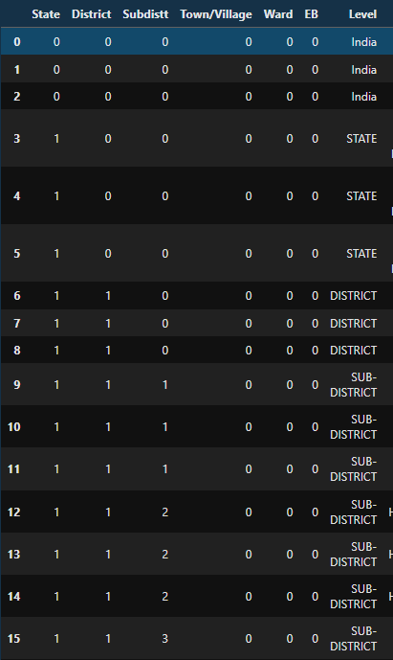
Data Exploration
Unique Data Structure:
The raw dataset stacks multiple levels of administrative hierarchy within a single file.
The Aggregation Problem:
Level 1: Row 1 represents the entire nation (India Total).
Level 2: Subsequent rows represent State totals.
Level 3: Further rows represent District totals.
The Analytical Risk:
A naive summation (e.g., df['Population'].sum()) adds National + State + District + Sub-district totals together.
Result: "Double Counting" error, inflating the population to approx 4x the actual value.

Slide 4
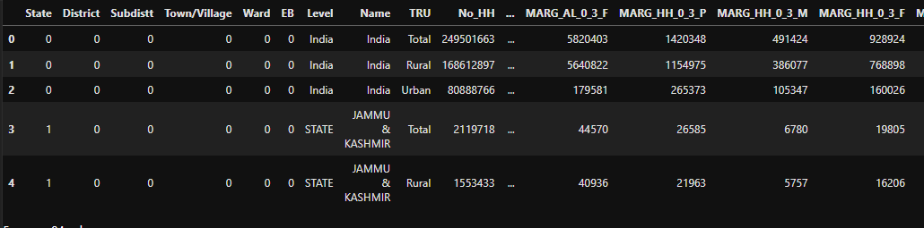
Dataset Overview
Data Source:
Origin: Census of India 2011, Office of the Registrar General & Census Commissioner.
File: 2011-IndiaStateDistSbDist-0000.xlsx
Scale & Dimensions:
Coverage: Comprehensive Pan-India data covering 35 States/UTs and 640 Districts.
Volume: The dataset consists of 19,992 rows and 94 columns.
Key Variables Analyzed:
Demographic: TOT_P (Total Population), TOT_M / TOT_F (Gender Breakdown).
Social: P_LIT (Literacy Counts), P_SC / P_ST (Caste & Tribe Status).
Economic: MAINWORK_P (Main Workforce), MARGWORK_P (Marginal Workforce).

Slide 5
Feature Engineering
Objective:
Raw counts (e.g., "50,000 literate people") are misleading when comparing districts of vastly different sizes.
Solution: Created normalized metrics (Rates & Ratios) to enable "Apples-to-Apples" comparison.
Key Features Created:
Literacy Rate (%):
(Literate Population ÷ Total Population) × 100
Sex Ratio = (Female Population ÷ Male Population) × 1000
Standard demographic metric used in India.
Work Participation Rate (WPR):
Formula: (Total Workers ÷ Total Population) × 100
Marginal Work Rate:
Formula:(Marginal Workers ÷ Total Workers) × 100

Slide 6
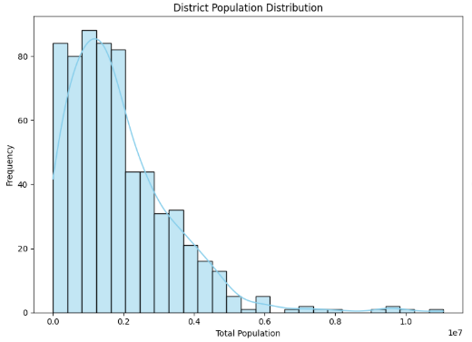
Univariate Analysis - Population Distribution
The "Long Tail" Phenomenon:
The histogram reveals a highly Right-Skewed Distribution.
Cluster: The vast majority of India's 640 districts are clustered on the left, with populations under 2 Million.
The Outliers (Mega-Districts):
The tail extends far to the right, representing massive urban districts like Thane and North 24 Parganas (10 Million+).
Key Insight:
The "Average District" size is misleading.
Governance challenges vary drastically: managing a small hill district is fundamentally different from managing a district with the population of a small European country.

Slide 7
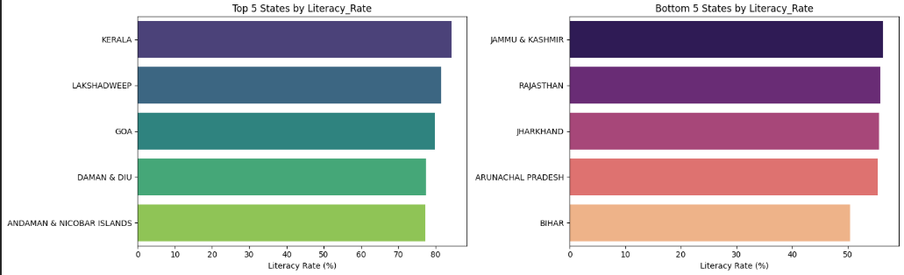
Insights Found - The Literacy Landscape
The National Picture:
India's average literacy rate stands at 62.05%.
However, state-level disparities are extreme.
The "North-South Divide":
Top Performers: Southern and North-Eastern states lead the chart.
Kerala: ~85% (Highest in India).
Lakshadweep: ~80% (High tribal literacy).
The Laggards: Northern and Central states fall significantly behind.
Bihar: ~50% (Lowest).
Rajasthan & Jharkhand: Struggle with rates below 57%.
Key Takeaway:
Geography is a strong predictor of education. The "BIMARU" belt (Bihar, MP, Rajasthan, UP) continues to drag the national average down.

Slide 8
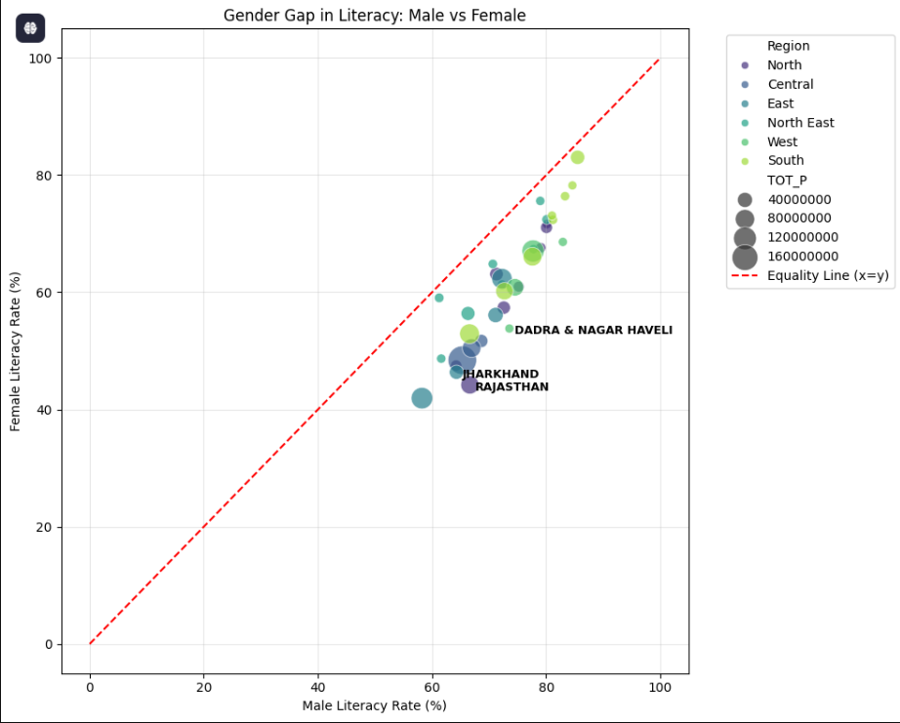
Bivariate Analysis - The Gender Gap in Literacy
The Metric: Comparing Male Literacy Rate (X-axis) vs. Female Literacy Rate (Y-axis).
The "Equality Line" (Red Dashed Line):
Represents perfect gender equality (y=x), where Male Literacy = Female Literacy.
The Reality Check:
Universal Gap: Every single state bubble lies below the red line.
Implication: There is no state in India where women are more literate than men.
Regional Disparities:
Best Performers (Top Right): Kerala and Mizoram are closest to the red line (Low Gap).
Worst Offenders (Bottom Center): Rajasthan and Jharkhand show the furthest distance from the line, indicating extreme gender inequality.

Slide 9
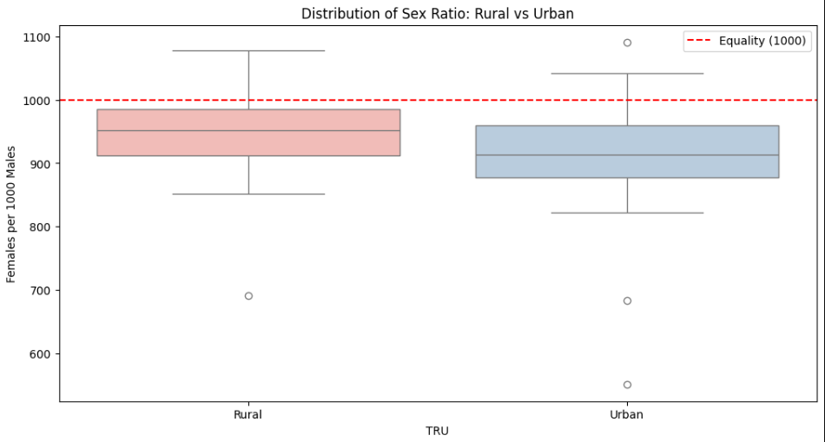
Insights Found - The "Urban Penalty"
The Metric: Sex Ratio (Number of Females per 1,000 Males).
The Counter-Intuitive Discovery:
Common belief: "Cities are more modern, so they should have better gender equality."
Data Reality: Urban areas consistently show a lower Sex Ratio than Rural areas.
Visual Evidence (Box Plot):
The Rural (Pink) Box has a higher median value.
The Urban (Blue) Box is shifted lower, with many outliers dropping below 800.
The Driver: Male-Selective Migration.
Men from rural hinterlands migrate to industrial hubs (like Daman or Delhi) for work, leaving families behind. This artificially distorts the demographics of Indian cities.

Slide 10
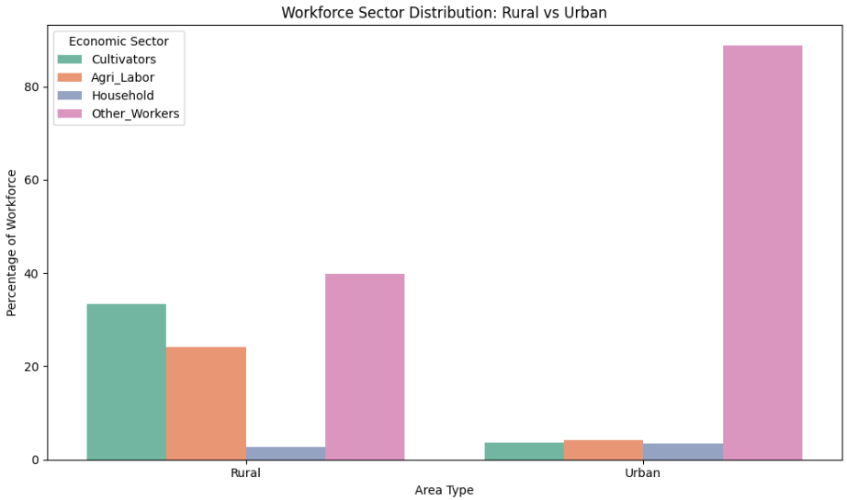
Economic Sectors - The Structural Divide
Objective:
To analyze where people actually work. (Comparison of 4 Census Categories: Cultivators, Agricultural Laborers, Household Industry, and Other Workers).
Urban Economy (The "Service" Engine):
Dominance: The Green Bar ("Other Workers") is massive (>80%).
Meaning: Urban India has successfully transitioned to a modern economy (Services, Manufacturing, IT, Government). Agriculture is negligible.
Rural Economy (The "Agrarian" Trap):
Dominance: Split between Cultivators and Agricultural Laborers.
Critical Insight: A significant portion of rural workers are Agricultural Laborers (working on others' land), not Cultivators (owners). This indicates high landlessness and economic dependency.
Conclusion:
There is no "mixed" economy. You are either fully Agrarian (Rural) or fully Service-based (Urban).

Slide 11
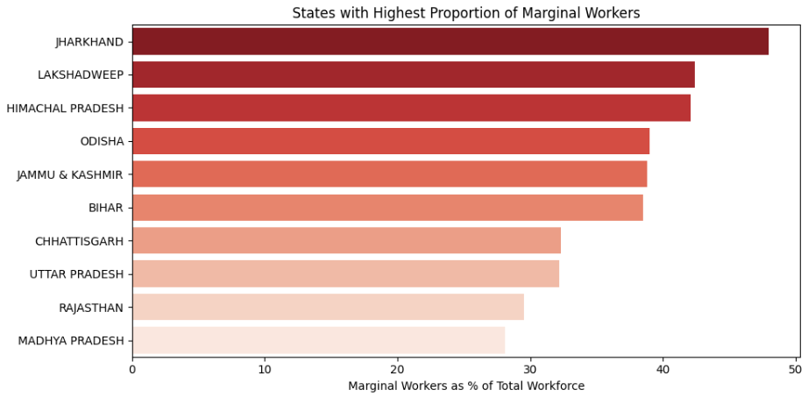
Insights Found - Workforce Vulnerability
The Metric: Marginal Work Rate.
Definition: The percentage of the workforce employed for less than 6 months in a year.
The Findings:
High Vulnerability States:
Jharkhand: Highest rate of marginal workers.
Himachal Pradesh & Odisha: Also show high dependency on irregular work.
Economic Implication:
High "Employment" numbers can be misleading.
In these states, a large portion of the population is underemployed, relying on seasonal agriculture or daily-wage labor rather than stable, year-round jobs.

Slide 12
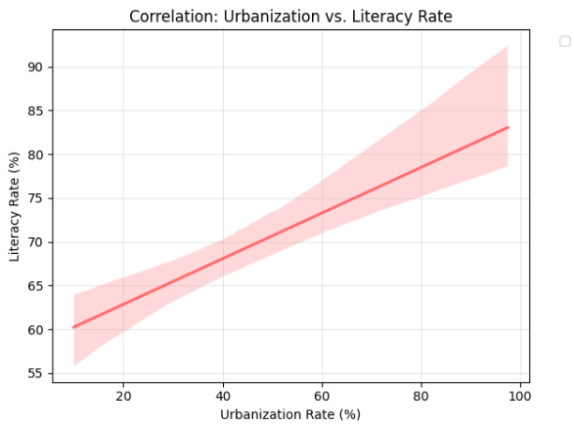
Urbanization vs. Literacy
Hypothesis Testing:
Does living in a city guarantee higher education levels? (Correlating Urbanization % with Literacy Rate %).
The Trend:
Positive Correlation: As expected, states with higher urbanization generally show higher literacy rates.
The Critical Exception (The "North-East Model"):
Observation: States like Mizoram and Tripura appear in the "High Literacy / Low Urbanization" quadrant.
Insight: These states achieve >90% literacy despite being largely rural. This proves that social infrastructure (schools/community) matters more than physical infrastructure (cities/roads) for education.

Slide 13
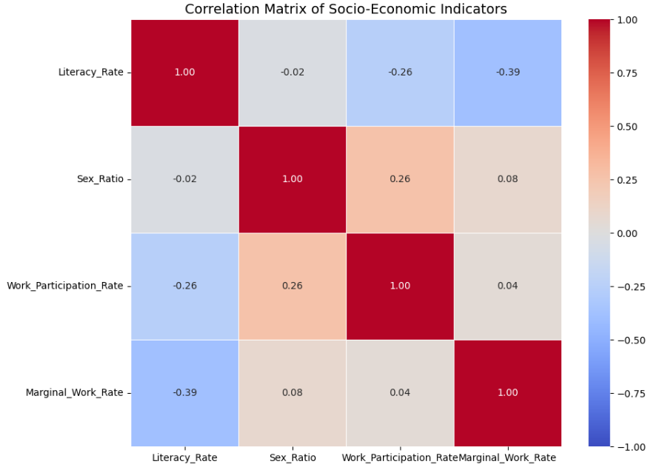
Multivariate Analysis - Correlation Matrix
Objective:
To statistically measure the strength of relationships between multiple variables simultaneously.
Scale: -1.0 (Perfect Negative Correlation) to +1.0 (Perfect Positive Correlation).
Key Insight 1 (The Economic Shield):
Negative Correlation: Strong negative link between Literacy Rate and Marginal Work Rate.
Meaning: As education levels rise, the reliance on unstable, seasonal jobs decreases. Education acts as a shield against economic vulnerability.
Key Insight 2 (The Gender Disconnect):
Weak Correlation: Sex Ratio shows very little correlation with Literacy or Work Participation.
Implication: Improving education or employment rates does not automatically fix gender imbalance. The "Missing Women" problem is deeply cultural, not just economic.

Slide 14
Future Scope - Machine Learning & Policy AI
The Concept:
Moving beyond "State-level" policy to "Cluster-level" governance.
Algorithm Proposed: K-Means Clustering.
How It Works:
The model groups the 640 districts into distinct "clusters" based on similarity in data, not geography.
Potential Clusters:
Cluster A ("The Metros"): High Literacy, High Urbanization, Low Sex Ratio (e.g., Delhi, Bangalore, Mumbai).
Cluster B ("The Vulnerable Hinterland"): Low Literacy, High Marginal Work, High Tribal Population.
Cluster C ("The Developing Middle"): Average metrics, stable but slow growth.
The Advantage:
Allows the government to design Targeted Policy Bundles. A policy for "Cluster B" would work for districts in both Odisha and Madhya Pradesh simultaneously.

Slide 15
Conclusion - The Three Paradoxes of Development
1. The "Averages" Trap:
Our analysis proved that national averages are dangerous. A "74% Literacy Rate" hides the reality of districts like Alirajpur (37%) vs. Serchhip (98%).
Verdict: Governance requires granular, district-level data, not state-level generalizations.
2. The Urban Gender Paradox:
We debunked the myth that "Modernization = Equality."
Verdict: Urbanization currently penalizes women due to male-selective migration. Cities need family-centric housing policies to fix this skewed sex ratio
.
3. The "Hidden" Workforce:
High employment rates in states like Jharkhand are an illusion created by "Marginal Work."
Verdict: Economic health should be measured by Work Consistency (>6 months), not just "Job Holding."

Slide 16
Thank you

